Slide 1
Ticket Analysis with Markov Chain
How a Markov Chain can be used to analyze service tickets and generate data
11-14-2018
Don Bacon

Slide 2
In This Exciting Hour we will cover…
What problems are we trying to solve?
What is a Markov Chain?
Some applications
Examples
How Markov Chain can be used to analyze service tickets
The Collector-Producer Pattern
Using Markov chain structure to analyze and produce all kinds of data
Framework and technologies
Opportunities for improvement
Live demo
And more!

Slide 3

But First…
A story
Fun Fact: A good story is Authentic, is Creative, makes an Emotional and Personal connection, takes the Audience on a Journey.

Slide 4

I was curious
About brand drug names
Xarelto
Where do they come from?
Pradaxa
Any patterns to the names?
Xifaxan
Tremfya
Could I make software that could discover these patterns to create my own drug names?
Xeljanz
What else could I apply this to?

Slide 5


Which got me
about
What makes their music so special?
Any patterns to the chord progressions?
Could I make software that could discover these patterns to create my own “Beatles-esque” music?

Slide 6

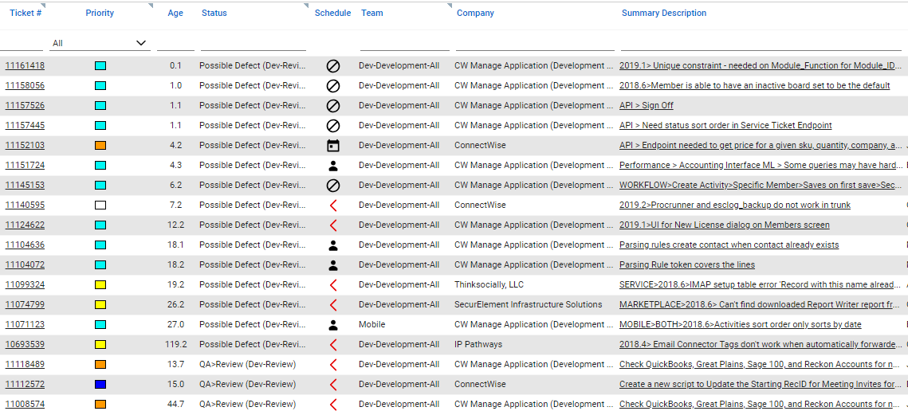
Then I Joined
Looking at Service Boards got me to wondering…
What are the big problem areas?
What are the categories to focus on?
Could I make software that could pull that out of service tickets?

Slide 7
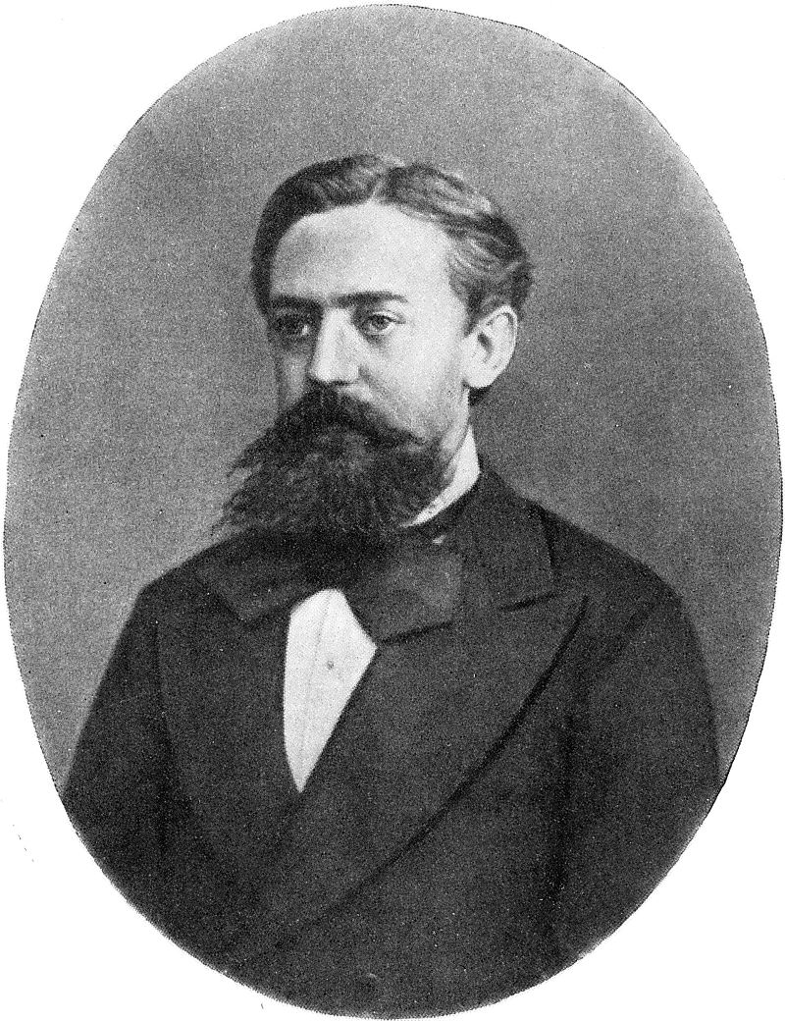
What do the problems around drug names, The Beatles and service tickets and all have in common?
Markov Chain
Andrey Andreyevich Markov (1856 – 1922)

Slide 8
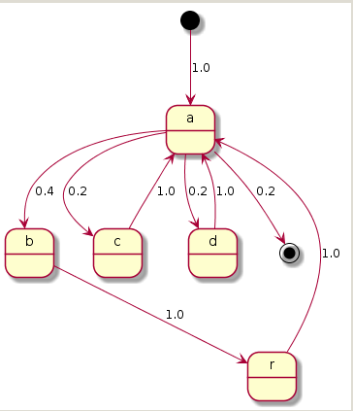
So What is a Markov Chain?
A structure describing a sequence of possible events in which the probability of each event depends only on the state attained in the previous event.
Simple text example: “abracadabra”
Not very interesting

Slide 9
For you Math types, a formal definition
A discrete-time Markov chain is a sequence of random variables X1, X2, X3, … with the Markov property: the probability of moving to the next state depends only on the present state.
A Markov chain with memory (Markov chain of order m) is a process where the future state depends on the past m states.
We are interested in absorbing Markov chains with memory

Slide 10
Some Applications
Text analysis
Unstructured text as in prose
Structured text in JSON format
Service Tickets
Twitter feeds
Speech recognition (hidden Markov models)
Markov modelling of the English language (I have a demo)
Google’s page rank of a webpage is defined by a Markov chain
Algorithmic music composition (more on that later!)

Slide 11
Order 1 Markov Chain State Transition Diagram
Service Tickets (sample)
0.02857
import
0.15385
0.15385
0.06098
0.64634
0.02439
0.02439
tool
utility
spreadsheet
0.07143
0.11429
0.08571
product
map
add
0.15385
0.15385
configuration
0.04286
0.02857
adjustment
occurrence
enhancement
issue

Slide 12
Markov Chain with Memory
Number of remembered states is the Order of the Markov Chain.
To use the Import example (click the mouse!)

Slide 13
Order 2 Markov Chain State Transition Diagram
0.03774
5 other
22.64%
import tool
35.85%
0.01887
19 other
15.1%
11.3%
9.4%
5.6%
3.7%
configuration
map
add
issue
ui

Slide 14
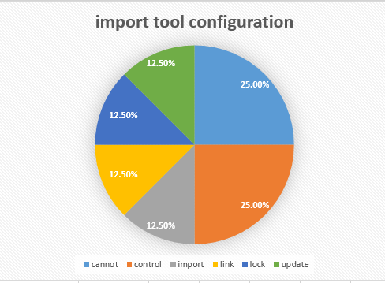
Markov Chain order 3 “import tool configuration”
{ "import tool configuration" : {
"totalOccurrence" : 8,
"cannot": {
"occurrence" : 2, "probability" : 0.25
},
"control": {
"occurrence" : 2, "probability" : 0.25
},
"import": {
"occurrence" : 1, "probability" : 0.125
},
"link": {
"occurrence" : 1, "probability" : 0.125
},
"lock": {
"occurrence" : 1, "probability" : 0.125
},
"update": {
"occurrence" : 1, "probability" : 0.125
}
} }

Slide 15
Collector – Producer Pattern
Collector – Creates an order-n Markov Chain from source Data
Producer – Creates data based on Markov chain probabilities
Raw Data
Collector
Markov chain
Producer
Simulated Data
Dolibroxa
Dulacia
Edigoxa
Furanexa
Glynpati

Slide 16
Framework and Technologies Used
Git Hub Projects
math-lib : base classes, interfaces, fractals, utility classes
text-processing : Collector-Producer for text, POS patterns
music-framework : musical structure, notation and theory for composition and analysis including Collector-Producer; MusicXML generation from fractals
Technologies
Java 10 – Jackson for JSON
Apache ActiveMQ
MongoDB
Gradle and Jenkins
SonarQube code analysis
MusicXML library
AWS S3 (as a data source/target)
Python (pulling service tickets)

Slide 17
Collector – Producer Examples
Collector | Markov Chain | Producer | Output
CharacterCollector | MarkovChain<Character, Word> | WordProducer | Set<Word>
WordCollector | MarkovChain<Word, Sentence> | SentenceProducer | Set<Sentence>
HarmonyChordCollector | MarkovChain<HarmonyChord, ChordProgression | ChordProgressionProducer | ChordProgressionScrapbook
Collect
From
To Produce
Interface
Characters
Sentence
Words
ICollector<Word, MarkovChain<Character, Word>, Sentence>
Words
Book
Sentences
ICollector<Sentence, MarkovChain<Word, Sentence>, Book>
HarmonyChords
Song
ChordProgressions

Slide 18
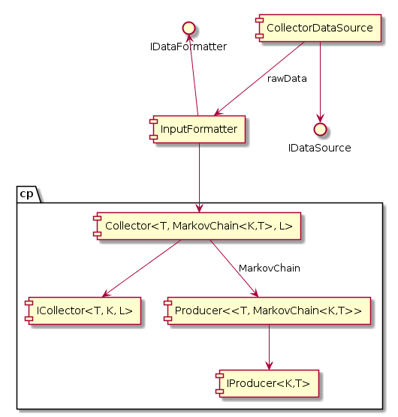
Collector/Producer Components
Collector

Slide 19
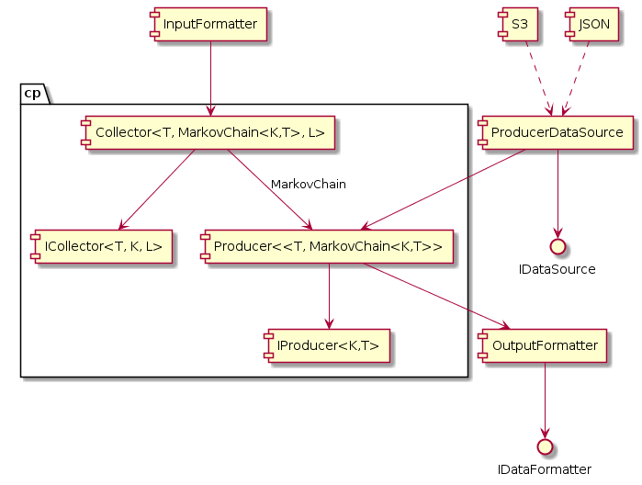
Collector/Producer Components
Producer

Slide 20
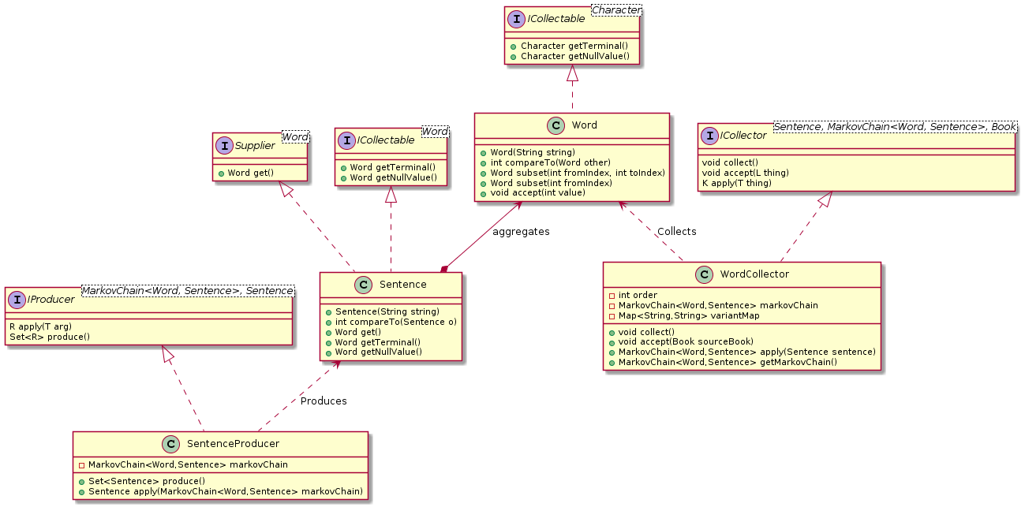
If you’re a fan of Class Diagrams…

Slide 21
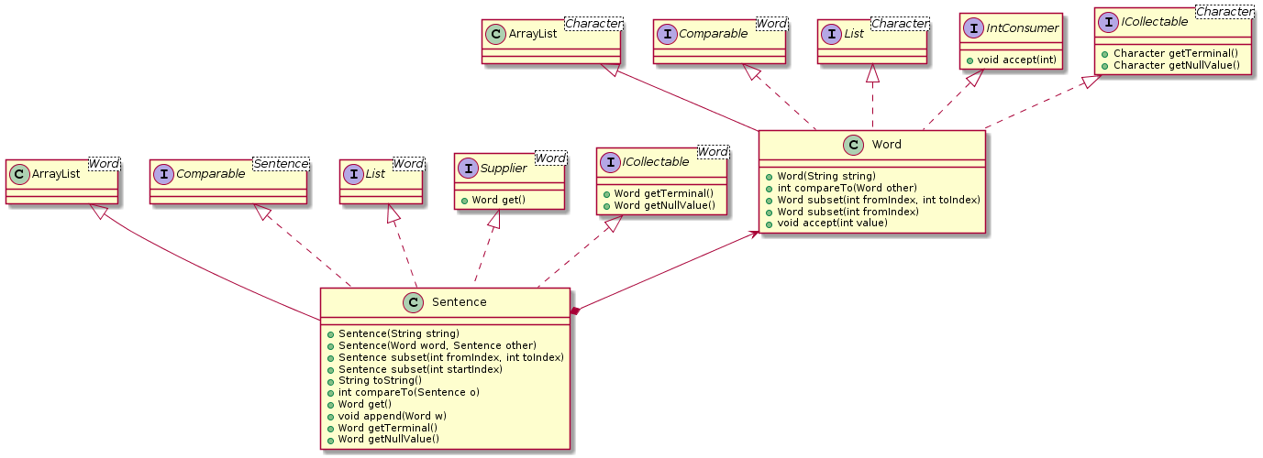
Word - Sentence

Slide 22

Live Demo
CharacterCollector / WordProducer
Order 1 text (abracadabra)
Order 3 drug names
WordCollector
tickets_sample.json – small sample of 68 records
tickets_out Dev-Review.json – 1000 records, order 2
tickets_small_sample.json – order 2, csv output
HarmonyChordCollector
Beatles – order 3
ChordProgressionProducer
Beatles – order 2

Slide 23
Opportunities for improvement
Collection Data Preparation
Easy to get close – hard to get right
Extended character sets, Unicode, punctuation
Similar words, verb tense, singular/plural
eg. tool – tools, config - configuration
Collector results presentation
Viewing Markov chains unwieldy
Need interactive approach
Context is everything (eg. service board)

Slide 24
Opportunities for improvement contd.
Framework extensions
Multi-dimensional Markov chain (related topics)
For example, ticket summary + resource to auto-assign
Combining sets of Markov chains of different orders
Real-time collecting and user interaction
Dynamically adjust probabilities, keys etc.
Integrations with host applications
Part of a pipeline, for example to feed Python for post-processing
As a web service
Formalize notion of context (hidden Markov models)
Structure that supports “appears together”
Markov models only support “follows”
Other ideas?

Slide 25
Take-Aways
Markov chain and Collector-Producer are technologies that can be leveraged to provide insights into large data sets and even suggest where to focus investigation and resources.
It can be used to create data for testing and other creative uses.

Slide 26
Questions?
References
Markov chain Wikipedia Article
GitHub Projects
Math-lib
Music-framework
Text-processing

Slide 27



Slide 28
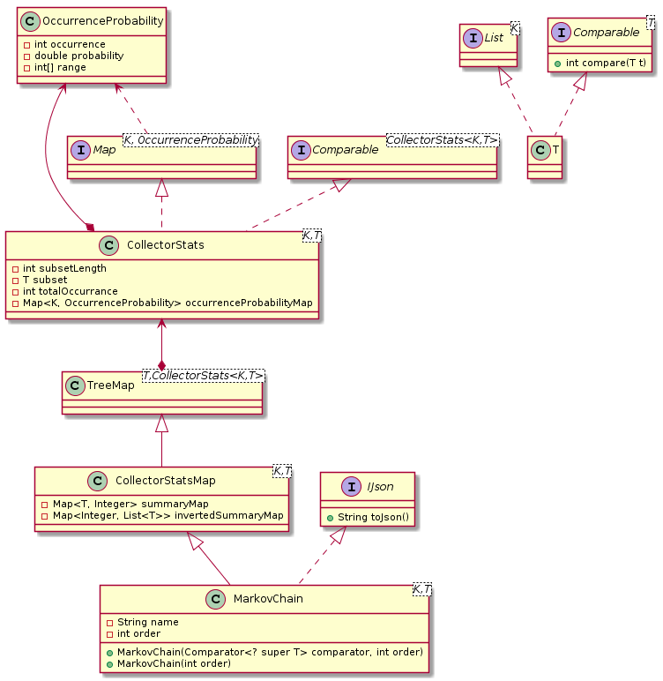
Extras

